Slide 1

Heartbleed Attack CVE-2014-0160
Critical vulnerability in OpenSSL implementation of TLS
Contributor: Shay Hahiashvili

Slide 2
Sources
Vox Article: The Heartbleed Bug, explained
CSO Article: The Heartbleed bug: How a flaw in OpenSSL caused a security crisis
ThreatDown Article: Five years later, Heartbleed vulnerability still unpatched
Heartbleed Bug Official Website
Wikipedia: Heartbleed Attack

Slide 3
What Is Heartbeat?
The Heartbeat extension was introduced to allow SSL/TLS endpoints (clients or servers) to verify that their secure connection was still active without having to renegotiate the entire session. It works by having one endpoint send a “heartbeat” message containing a small payload along with a declared payload length, to which the other endpoint responds by echoing back the exact payload. This mechanism reduces overhead by keeping connections alive through periodic checks.
In 2014, a critical vulnerability known as Heartbleed was discovered in the OpenSSL cryptographic library, which is widely used to secure internet communications through SSL and TLS. Due to a missing bounds check in OpenSSL’s implementation of the Heartbeat extension, attackers could exploit the flaw to request and receive up to 64 kilobytes of memory from a vulnerable system. This flaw, a buffer leakage, could lead to the exposure of sensitive information such as encryption keys, user credentials, and other private data.
Vulnerable code: memcpy(bp, pl, payload); //copies to memory without bound check.

Slide 4
How The Attack Was Performed
Exploitation Mechanism:
Step 1: Crafting a Malicious Request
The attacker sends a specially crafted Heartbeat request to the target server. This request includes a small payload such as "hi" but falsely claims a much larger payload length like 64KB.
Step 2: Processing the Request Without Validation
The vulnerable OpenSSL server receives the request but does not properly verify whether the claimed length matches the actual data size. Instead, it blindly prepares to echo back the requested number of bytes.
Step 3: Server Reads Extra Memory Data
The server allocates memory based on the claimed payload size and attempts to retrieve the requested data. However, it also reads beyond the intended payload, exposing sensitive information such as encryption keys, user credentials, or internal communications.
Step 4: Attacker Repeats the Process
The attacker can send multiple malicious requests, each retrieving different portions of memory. Since there are no authentication checks, the attack can be repeated indefinitely without being detected.
Step 5: Exploiting the Stolen Data
The extracted memory data can contain valuable secrets, which attackers can use to decrypt communications, steal user credentials, or impersonate legitimate users. This could lead to unauthorized access, data breaches, and further exploitation of the system.

Slide 5
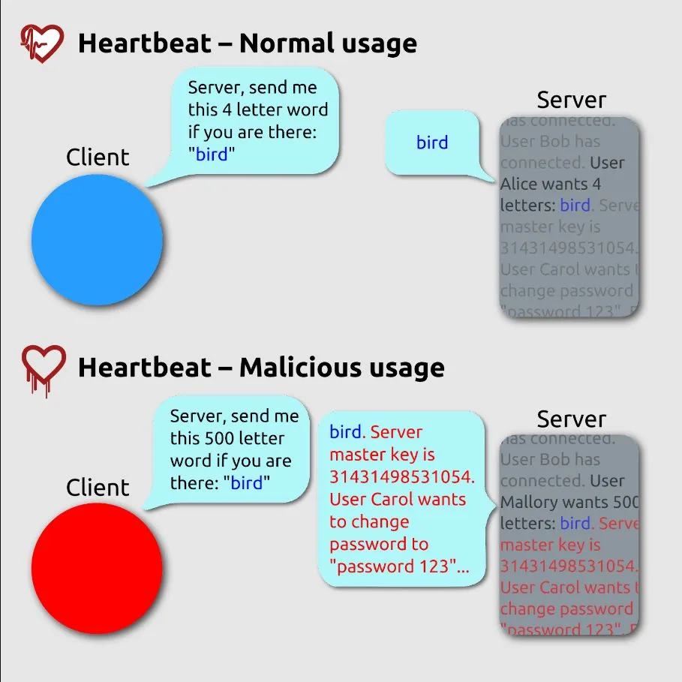
Heartbleed Attack Visualized
Normal Usage:
A client sends a small heartbeat request with message “bird” and specifies correct size, the server correctly responds with the same word.
Malicious Usage:
An attacker sends a heartbeat request claiming to be 500 letters in size, but the actual message is “bird” which is much smaller.
Due to the vulnerability, the server responds with extra memory beyond the intended message, potentially exposing sensitive information like encryption keys and user passwords.

Slide 6
Consequences of Heartbleed Attack
Stolen Data: Heartbleed exposed sensitive information across multiple sectors, leading to the theft of private data. For instance, the Canada Revenue Agency reported the theft of Social Insurance Numbers (SINs) from 900 taxpayers. Similarly, US Community Health Systems had 4.5 million patient records stolen, including names, birthdates, Social Security numbers, and other personal details.
Damages to Organizations and Trust: Heartbleed severely damaged trust in both organizations. The CRA’s exposure of 900 taxpayer SINs raised risks of identity theft and weakened confidence in their data protection. Similarly, US Community Health Systems lost 4.5 million patient records, compromising patient confidentiality and tarnishing its reputation.
Overall Risks and Impacts: Heartbleed created widespread risks, affecting personal data and organizational security. Cybercriminals exploited it to infiltrate forums, steal intelligence, and hijack accounts. Stolen private keys and data opened doors for further attacks, like Man-in-the-Middle (MitM) attacks, highlighting the urgent need for security updates and strong cryptographic protections.

Slide 7
Time Until Detection of Heartbleed Attack
Vulnerability Lifespan: Heartbleed had been embedded in OpenSSL since December 2011, giving attackers nearly two years to exploit systems undetected.
Public Disclosure & Awareness: Discovered independently by researchers at Codenomicon and Google Security, the vulnerability was publicly revealed on April 7, 2014. Codenomicon even launched a user-friendly website that rapidly spread awareness of the bug.
Detection Timeline: While some organizations noticed suspicious activity shortly after disclosure, many breaches were only uncovered after in-depth forensic investigations, highlighting delays in recognizing the attack’s full scope.
Stealthy Exploitation: The nature of the vulnerability allowed attacks to leave little to no traces in system logs, making detection of the attack difficult and delaying response efforts.

Slide 8
Recovery Time From Heartbleed Attack
Rapid Response & Prepared Fixes: In response to the April 2014 disclosure, organizations quickly began patching OpenSSL, revoking compromised certificates, and rotating cryptographic keys. Notably, the researchers collaborated with the OpenSSL team and key insiders to prepare fixes before the public announcement, thereby minimizing recovery time.
Comprehensive System Audits: Organizations conducted extensive security audits to identify and remediate vulnerable systems, ensuring that all instances of OpenSSL were updated to secure versions with the Heartbleed vulnerability fixed.
User Credential Resets: Many organizations advised users to change their passwords after patching their systems to mitigate the risk of compromised credentials.
Enhanced Monitoring and Detection: Organizations implemented improved monitoring and intrusion detection systems to quickly identify and respond to potential exploitation attempts of the Heartbleed vulnerability.

Slide 9
Conclusion
Heartbleed was one of the most severe cybersecurity vulnerabilities in modern history, exposing millions of systems worldwide to potential data breaches. The flaw, a critical buffer leakage in OpenSSL’s Heartbeat extension, allowed attackers to read sensitive memory contents, including private encryption keys, login credentials, and other confidential data. Its stealthy nature made detection difficult, enabling attackers to exploit it for over two years before public disclosure in 2014. The incident underscored the risks of software vulnerabilities in widely used cryptographic libraries and the devastating consequences of security flaws in foundational internet infrastructure.
Beyond immediate data theft, Heartbleed caused lasting damage by undermining trust in online security. Major organizations, including government agencies, healthcare providers, and financial institutions, suffered breaches, leading to identity theft, financial fraud, and reputational harm. The attack served as a wake-up call for the cybersecurity community, reinforcing the importance of strict code auditing, proactive security measures, and rapid incident response. It highlighted the need for continuous monitoring, timely patching, and stronger cryptographic protections to prevent similar vulnerabilities in the future.

Slide 10
Questions?

